Slide 1
Agile Presentation
Michael Abell

Slide 2
Agenda
Explain the various roles on a Scrum-agile Team by identifying each role and describing its importance.
Explain how the various phases of the SDLC work in an agile approach. Be sure to identify each phase and describe its importance.
Describe how the process would have been different with a waterfall development approach rather than the agile approach you used. For instance, you might discuss how a particular problem in development would have proceeded differently.
Explain what factors you would consider when choosing a waterfall approach or an agile approach, using your course experience to back up your explanation.

Slide 3
Various Roles

Slide 4
4 Primary Roles on an Agile Team
Product Owner
Communicates with the client
Scrum Master
Leads a daily meeting called stand up
Developer
Develops code based on user stories
Test newly written code
Tester
Gathers and documents requirements
Communicates requirements to team via User Stories
Prioritizes work items such as User Stores, bugs and issues.
Designs and reviews Sprints
Works with testers on acceptance criteria for test cases.
Provide feedback to developers for
Pass/Fail test case to resolve or further User Stories
1
2
3
4

Slide 5
Various Phases

Slide 6
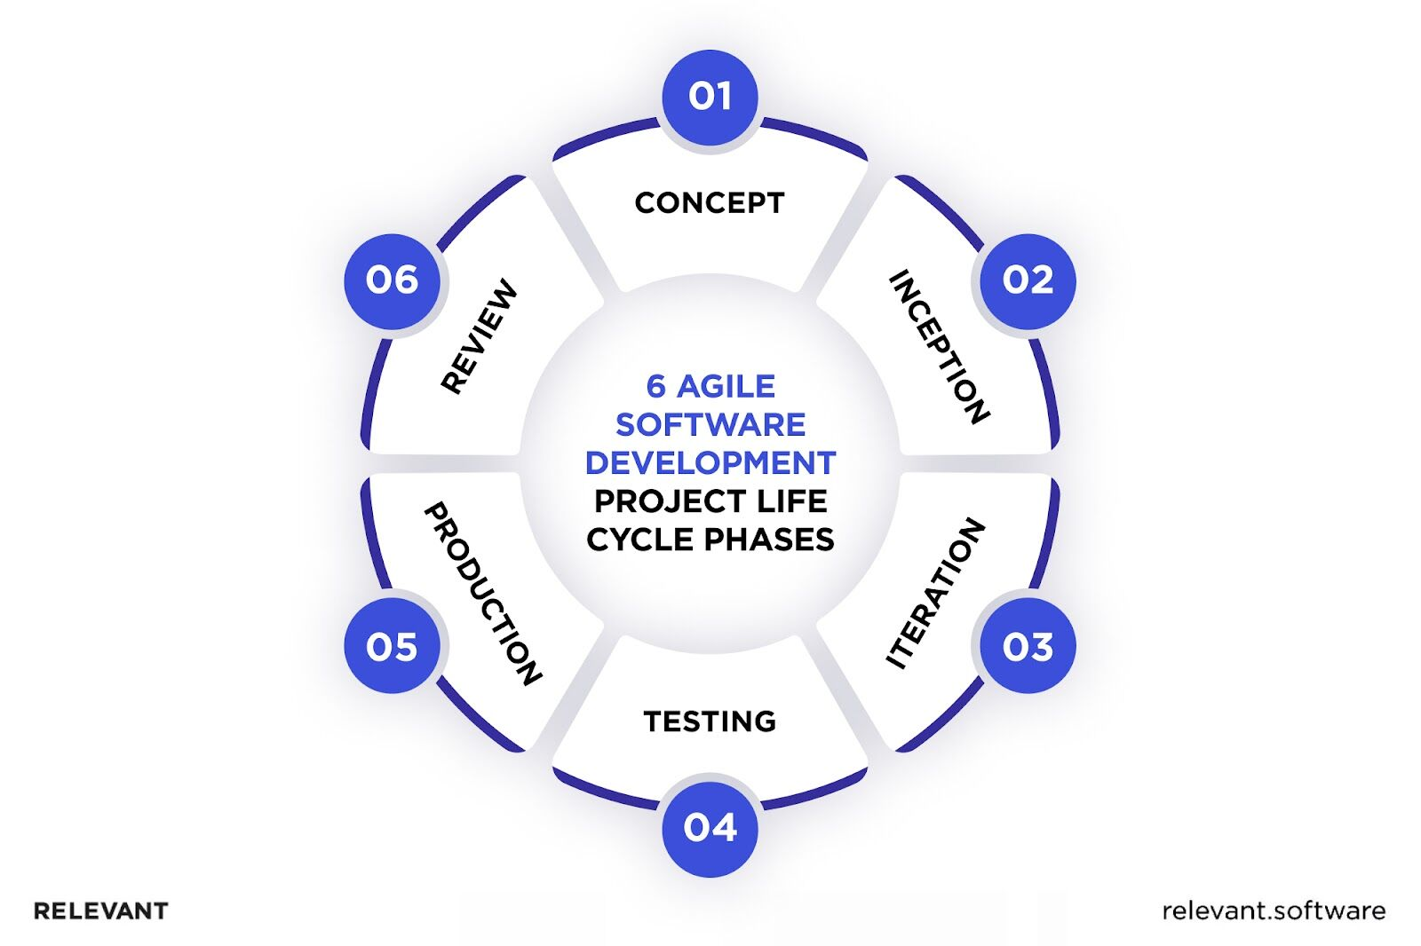
Phases of Agile
(Dziuba, 2023)

Slide 7
Agile vs Waterfall

Slide 8
Agile(New) vs. Waterfall(legacy)
Agile methodology permits real time pivoting of requirements and deployment. It manages the holistic resources of the team 100% of the time. In our most recent project, the user interface change mid stream and the team didn’t miss a beat adapting. In waterfall the project would have had to shut down to reconfigure.
Waterfall methodology statically overloads upfront development and depends on unchanging requirements and an uncertainty that task are progressing appropriately.

Slide 9
Factors to consider

Slide 10
When to chose one over the other
Your team is energetic and ready to problem solve in real time. Communication and accountability are important to the organization. Management of personnel resources are important. Requirements may not be static and flexibility is required.
Your team is doing a task that is repeatable and not able to be automated. No flexibility is needed. Previous results are satisfactory with no need for improvement. The team does not need real time communication.
Agile
Waterfall

Slide 11
References:
* Dziuba, A. (2023, April 6) Navigating the Agile Software Development Life Cycle: Phases, Tools, Roadmap. Relevant. https://relevant.software/blog/agile-software-development-lifecycle-phases-explained/

